Slide 1
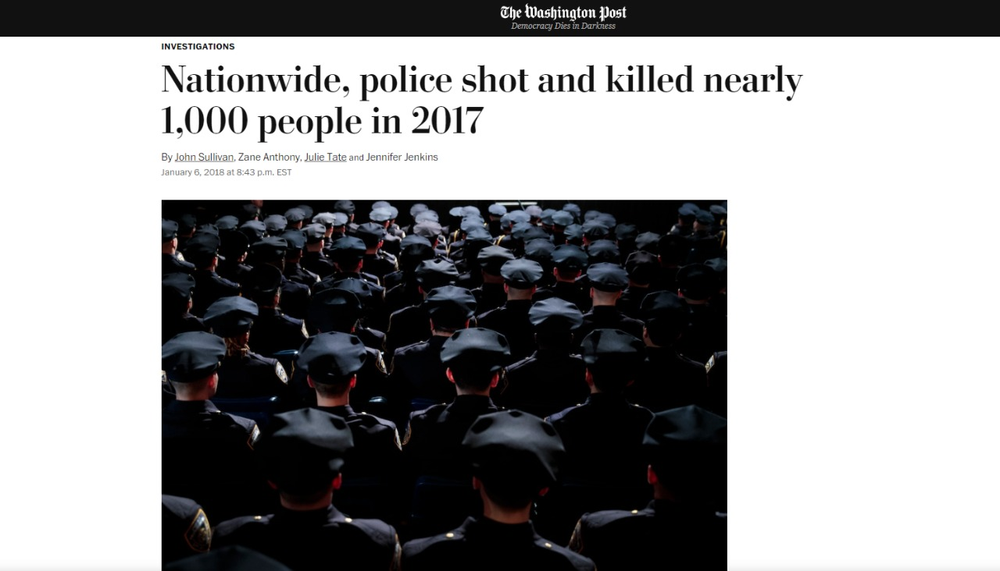
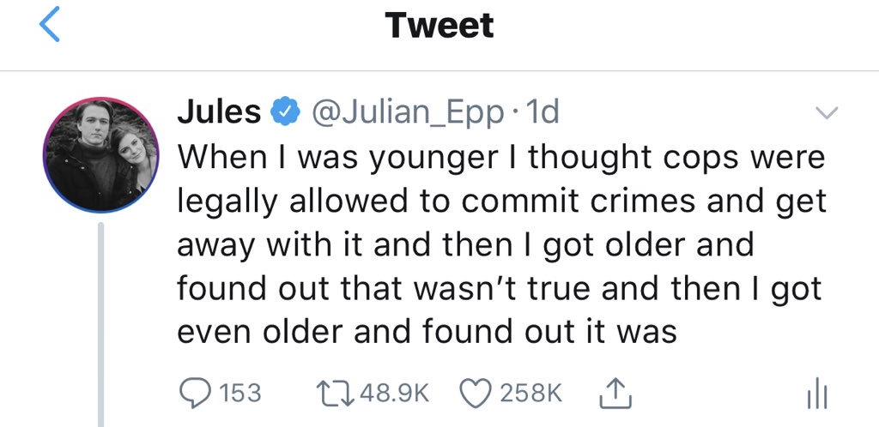
Is Police violence still a major problem in USA?

Slide 2
An Analysis on US Police shootings from 2015 to 2022.
D22005 – Amar A
D22008 – Anurag Shete
D22050 – Vishnudas T

Slide 3
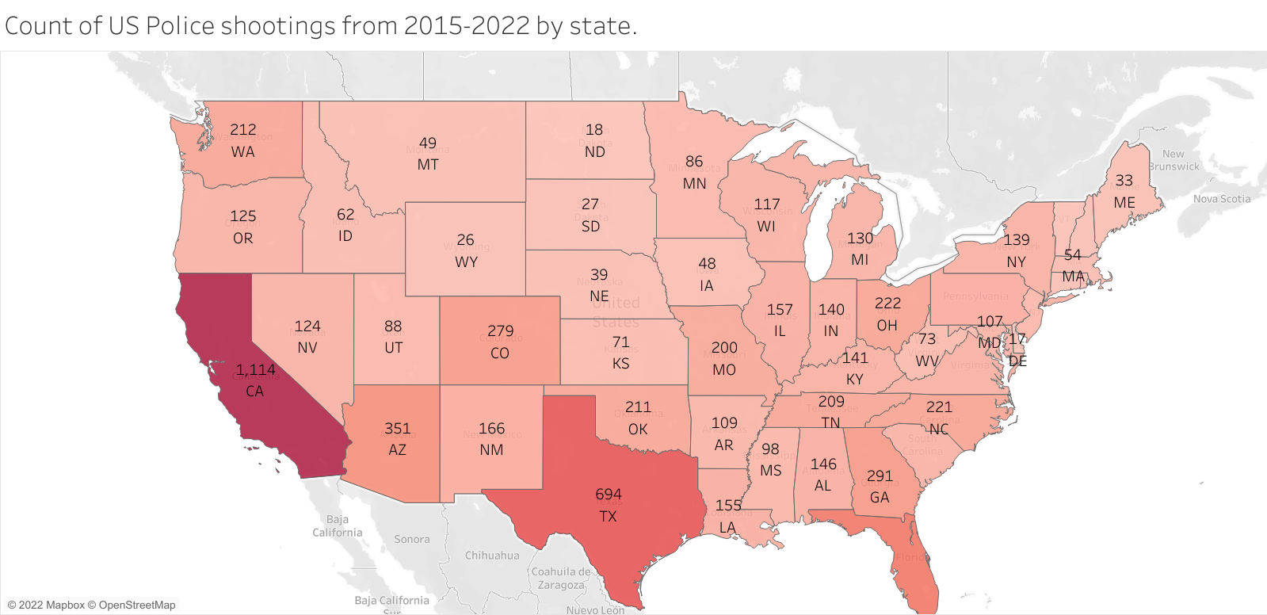

Slide 4
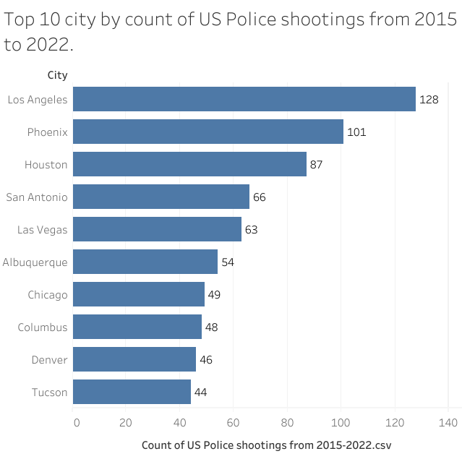
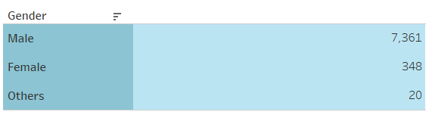

Slide 5
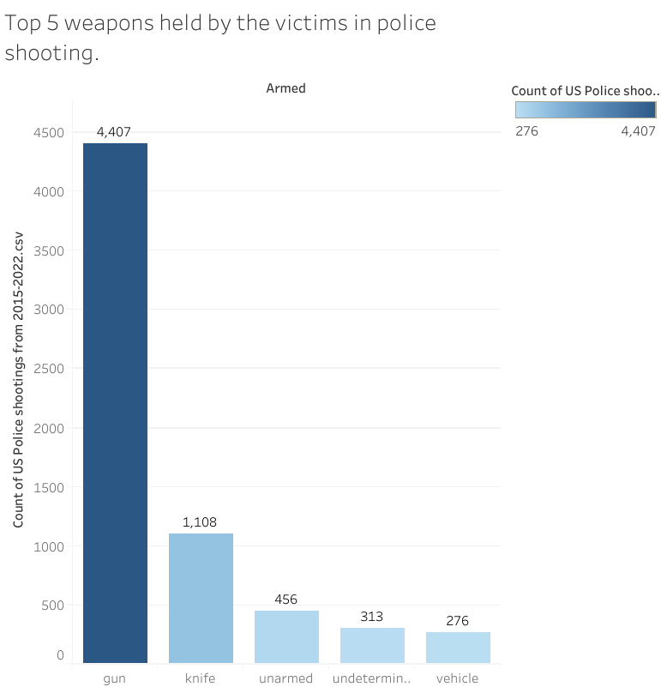
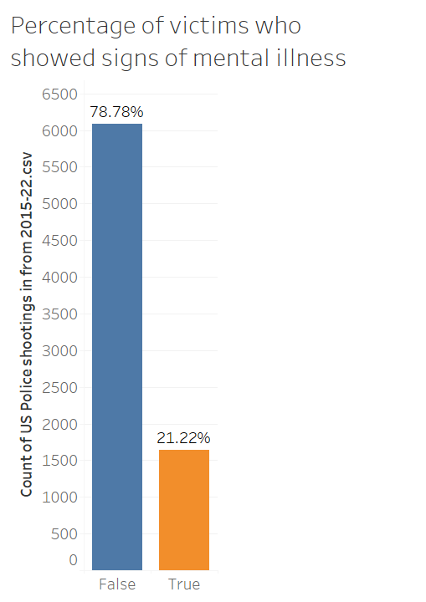

Slide 6
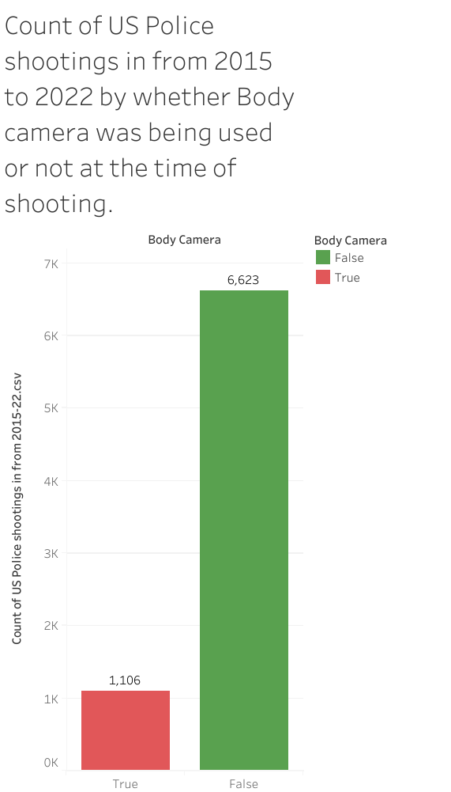
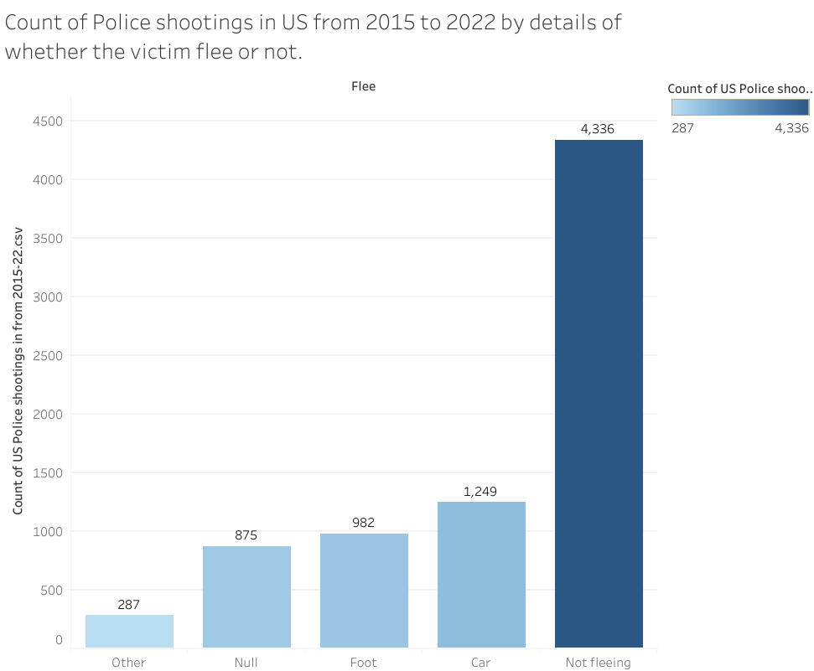

Slide 7
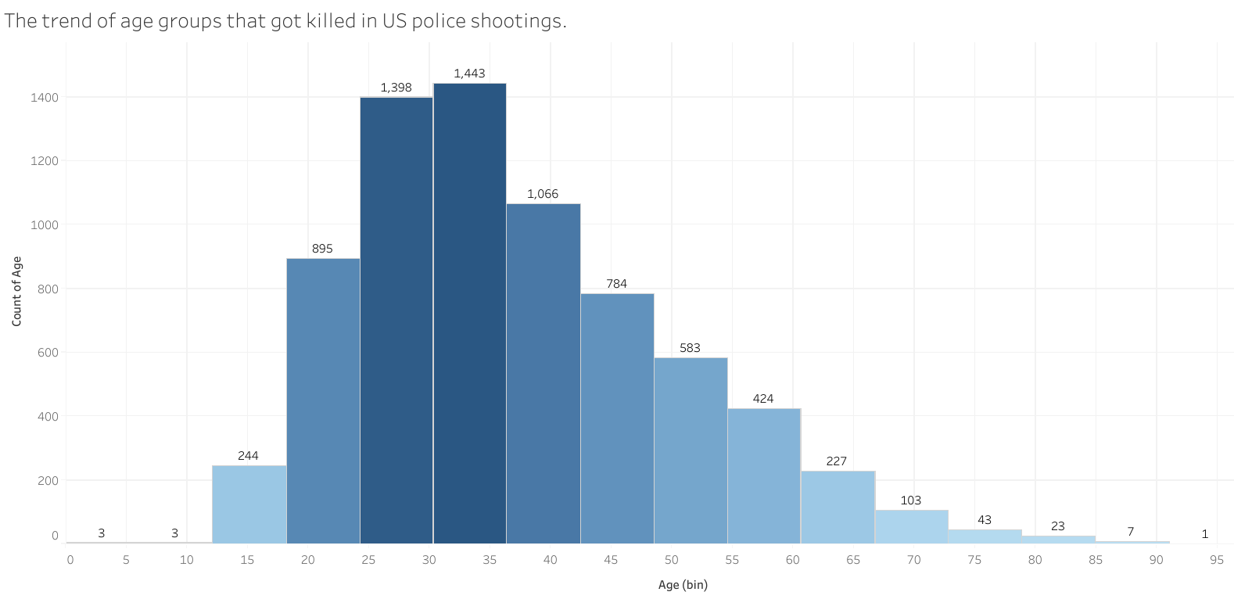

Slide 8
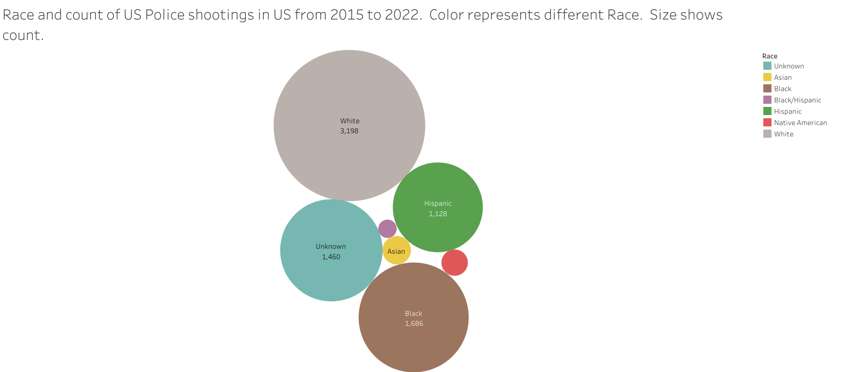
Police shootings by race
White: 41.38%
Black: 21.81%
Hispanic: 14.59%
Asian: 1.46%
American Indian: 1.26%
Multiple races: 0.61%
Unknown : 18.89%
US Population by race
White: 60.1%
Black: 12.2%
Hispanic: 18.5%
Asian: 5.6%
American Indian: 0.7%
Multiple races: 2.8%
Others : 0.2%

Slide 9
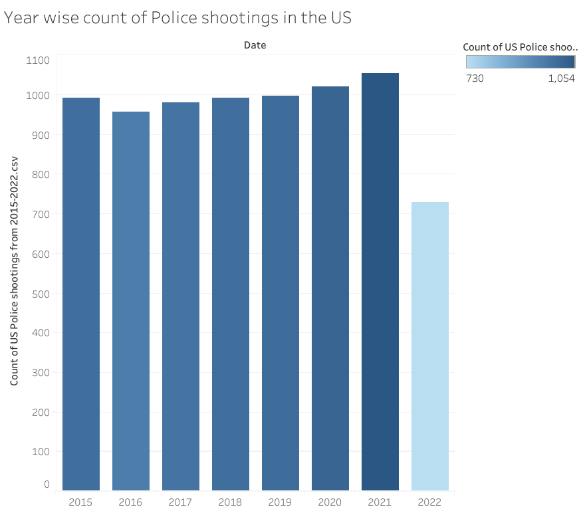
The number of Police shootings in US is slightly increasing every year and it is becoming a major issue.

